Slide 1
S.O.L.I.D Principles of Object Oriented Design
Atif Malik
Software Engineer, .NET Developer.

Slide 2
Agenda
Definitions for and differences between:
“Design Principles,” and
“Design Patterns”
Definitions for the S.O.L.I.D principles (mostly taken from Wikipedia),
Code Samples for each of them in Visual Studio, covering:
“Before” scenario – how the code looks when violating a principle,
“After” scenario – take the example from “Before,” and refactor to abide by the principle
General “Design Smells,” indicating the need for applying one or more principles,
Roundup of some design “patterns” that we visited,
Summary,
Appendices (may not have time to cover in the video).

Slide 3
Software Design Principles
An overarching, prescriptive method of software development. Some examples:
Abstraction:
A process of generalization by reducing the information content of a concept (Wikipedia). Examples would be the use of “Interfaces,” and “abstract classes” in C#,
Modularity – division of software into components and modules:
(definitions of “Components,” and “Modules” are somewhat arbitrary),
Information Hiding – sparing use of “public” accessor in favor of “internal,” “protected,” and “private” (Defensive Programming),
Tell, don’t ask
(we’ll cover this in “Dependency Injection Principle”),
DRY (Don’t Repeat Yourself) – same as “Reusability,”
SOLID.
N.B.: This is not an exhaustive list. More on https://en.wikipedia.org/wiki/Software_design

Slide 4
Software Design Patterns
Means of achieving “principles” stated on the previous slide. Some examples:
Use of “Factory” pattern to achieve “Reusability” through polymorphism,
Use of MVP, MVC, MVVM to achieve “Single Responsibility,”
Use of “Strategy” pattern to achieve “Dependency Injection,” “Single Responsibility,” “Open-Closed,”
(“Strategy” is most basic, most common pattern),
Some others to follow
Stay tuned…

Slide 5
SOLID – The Acronym
Letter | Principle
S | Single Responsibility
O | Open-Closed
L | Liskov Substitution
I | Interface Segregation
D | Dependency Inversion

Slide 6
‘S’ – Single Responsibility Principle (SRP)

Slide 7
Definition
SRP states that every context (class, function, variable, etc.) should have a single responsibility, and that responsibility should be entirely encapsulated by the context. All its services should be narrowly aligned with that responsibility. (Wikipedia).
The term was first used by Robert C. Martin, in an article by the same name – “There should never be more than one reason for a class to change.”
SRP promotes loose coupling amongst, and greater cohesion in, modules (or components).

Slide 8
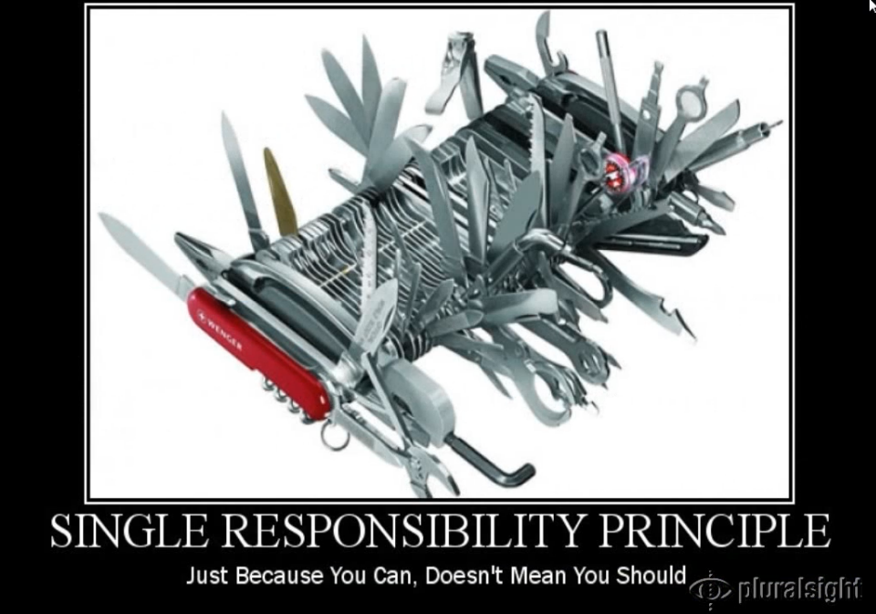
What SRP violation would look like

Slide 9
Solid.SRP.After – Mediator Pattern 1
Registration of Colleagues
Notification Queue
M3
C4
M1
Mediator
M2
C2
C1
M1
C1
C3
C5
M2
M1
C2
M1
M3
C5
C3
C4

Slide 10
Solid.SRP.After – Mediator Pattern 2
Notifications
Notification Queue
C3
M2
M3
C4
Mediator
M2
C2
M1
C1
C3
C5
C6
M3
M1
C7

Slide 11
Credits
Wikipedia.
PluralSight course on SOLID by Steve Smith: http://www.pluralsight.com/courses/principles-oo-design
Project “Solid.SRP.After” was inspired by this blog post: https://marlongrech.wordpress.com/2008/03/20/more-than-just-mvc-for-wpf/
Design Patterns Library, on PluralSight, multiple authors: http://www.pluralsight.com/courses/patterns-library
Raise Base Class Events in Derived Classes: https://msdn.microsoft.com/en-us/library/hy3sefw3.aspx

